Slide 1
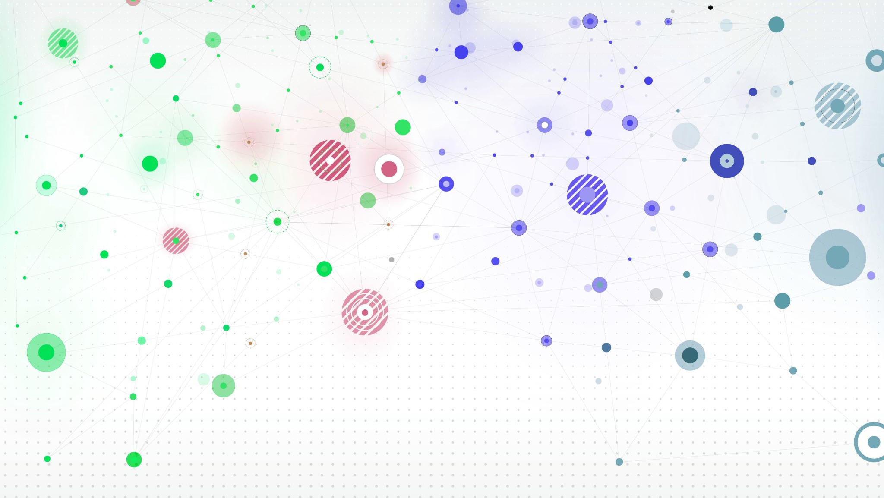
Building a Web Application on AWS
Hussain Ali
NV21073

Slide 2
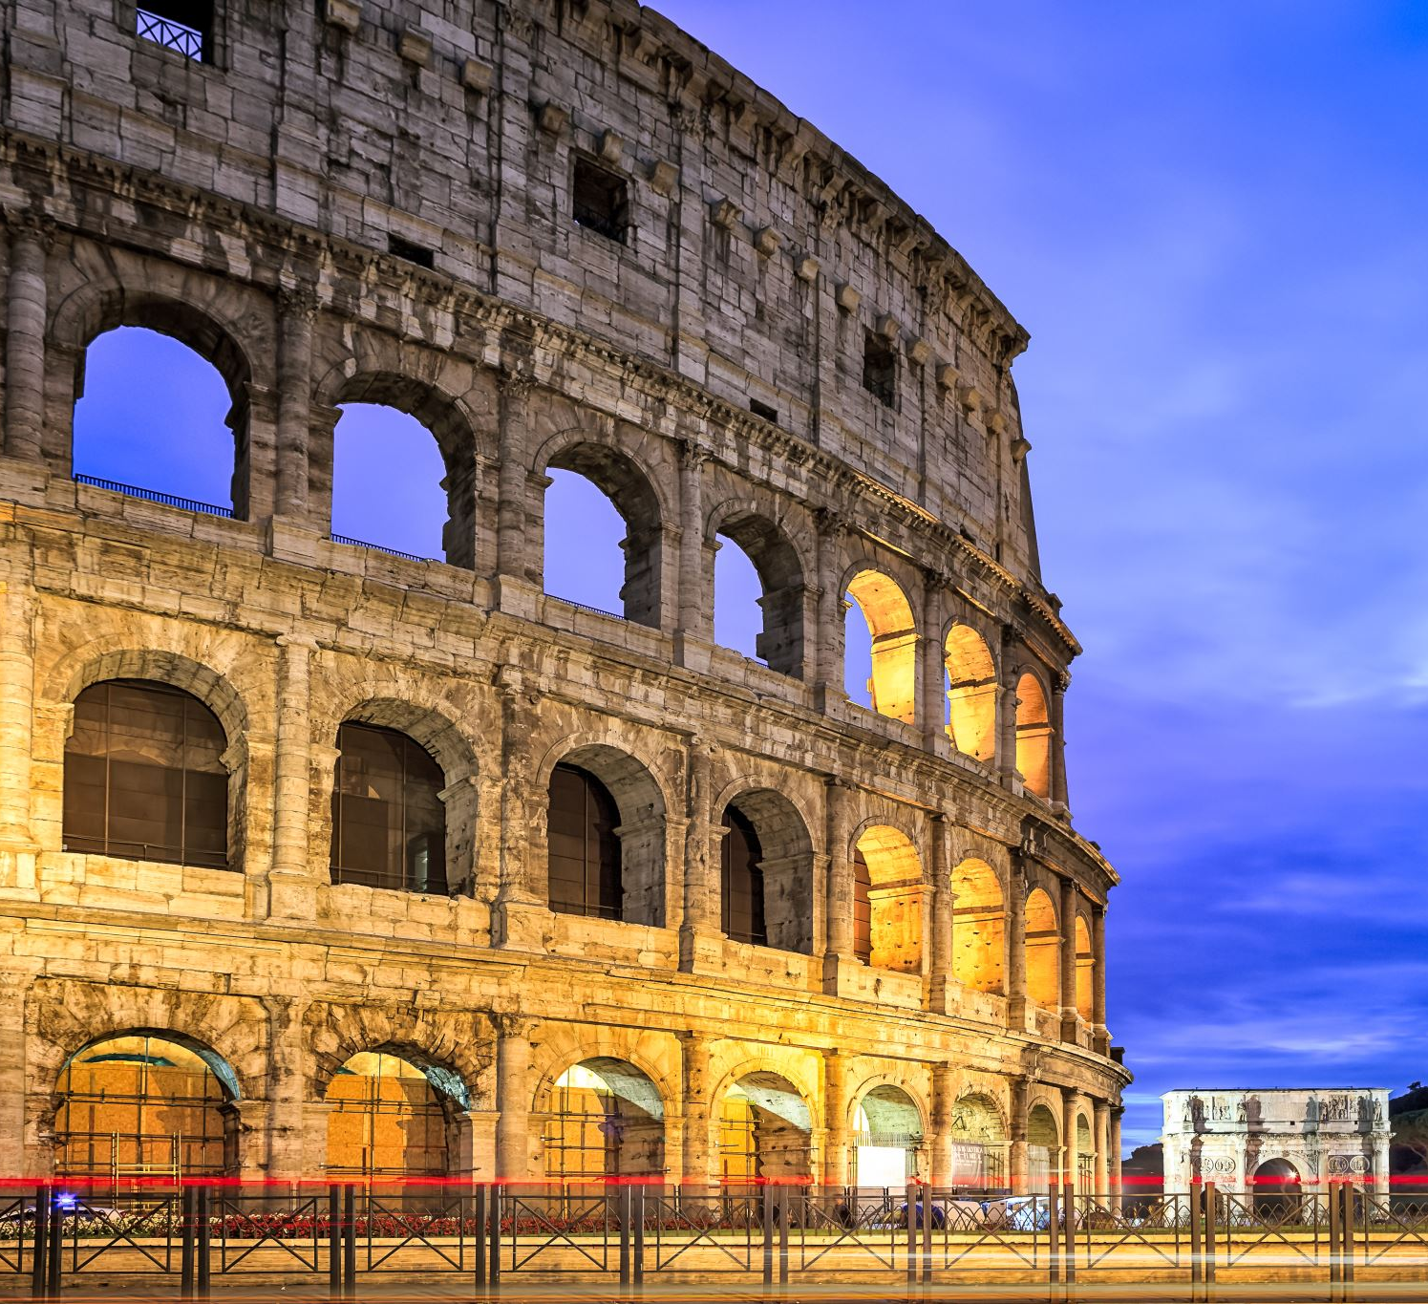
Introduction
I built a website on AWS that mainly focuses on the Seven Wonders of The World. Also, the website is design where it can help you learn more about old historical places . The website will provide pictures and dates and even description about each place on the world

Slide 3
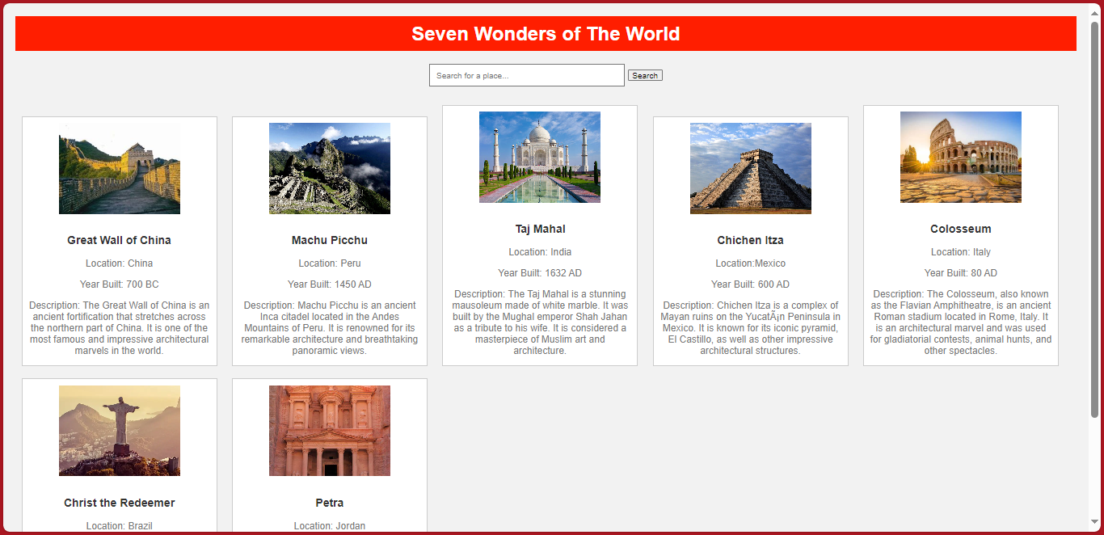
My Website

Slide 4

How the website work:
The website is hosted on AWS S3
The website helps you discover thing about old wonders of the world
The websites is reliable and scalable and secure
It has a search button that gives you the ability to search for specific things

Slide 5

What is S3(Simple Storage Service) ?
Amazon Web Services S3, sometimes called Amazon S3, stands for Amazon Simple Storage Service. It’s one of AWS’s many programs and is designed to store, protect, and then allow customers to retrieve data from discrete buckets anytime and anywhere on any appropriate device.

Slide 6
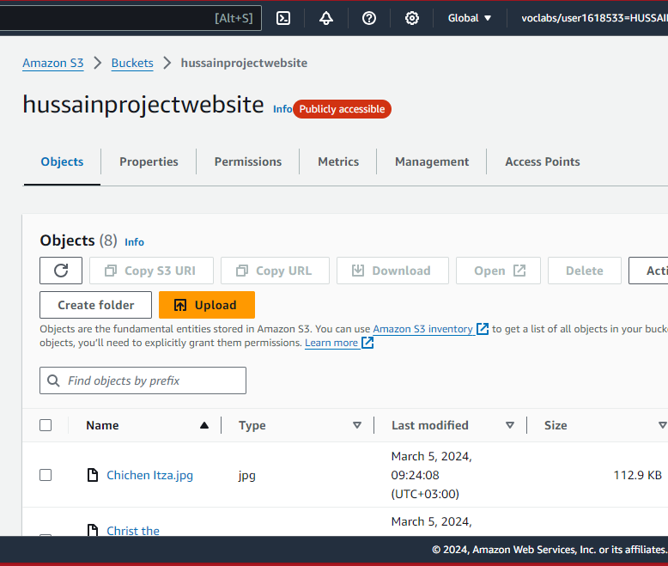

The bucket the is used to create this website

Slide 7
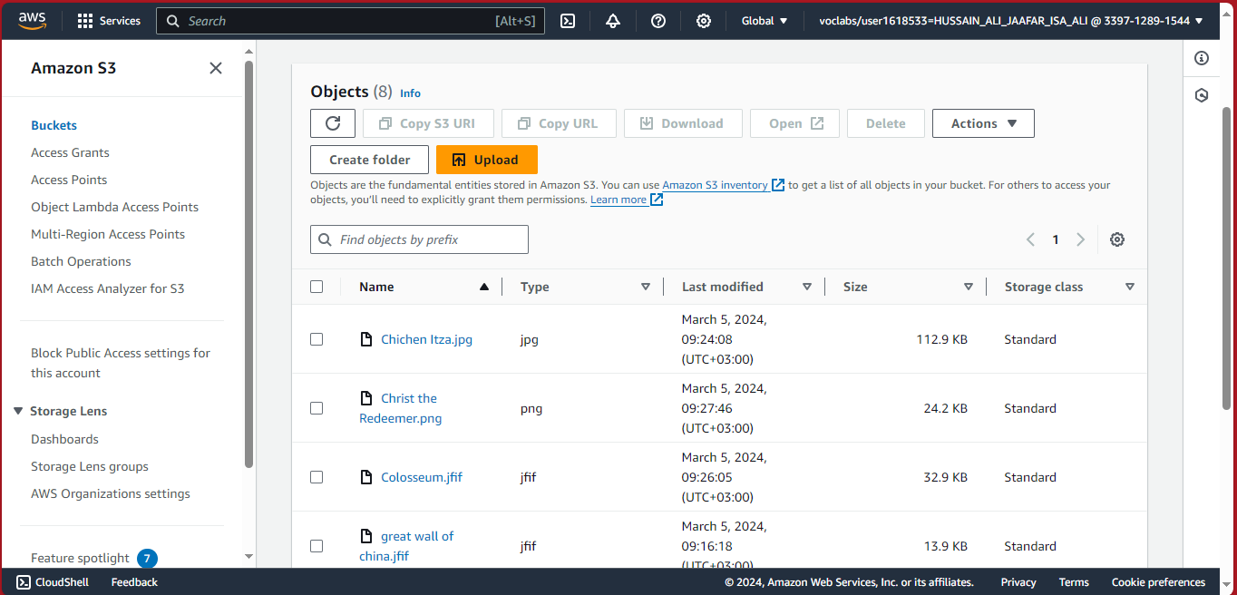




Some of the objects that I used for the website:

Slide 8
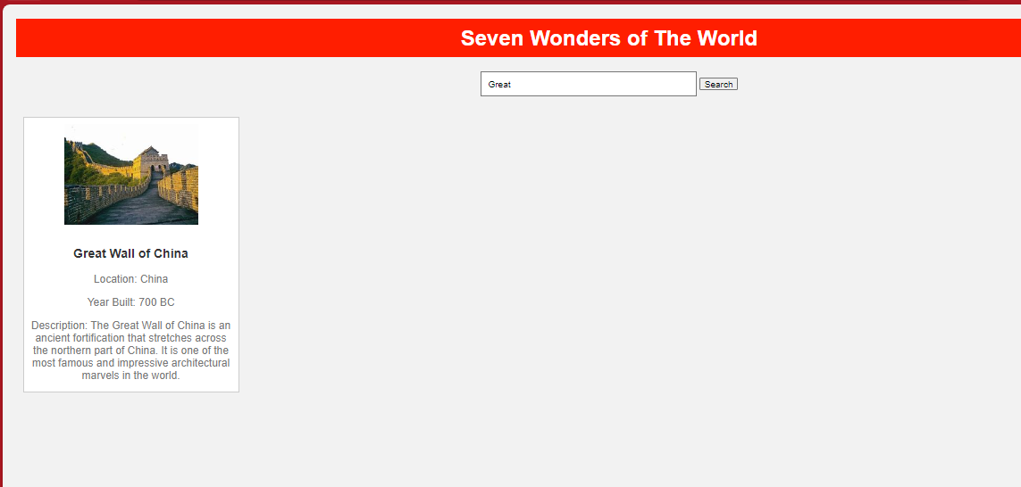
Picture of the search button working

Slide 9
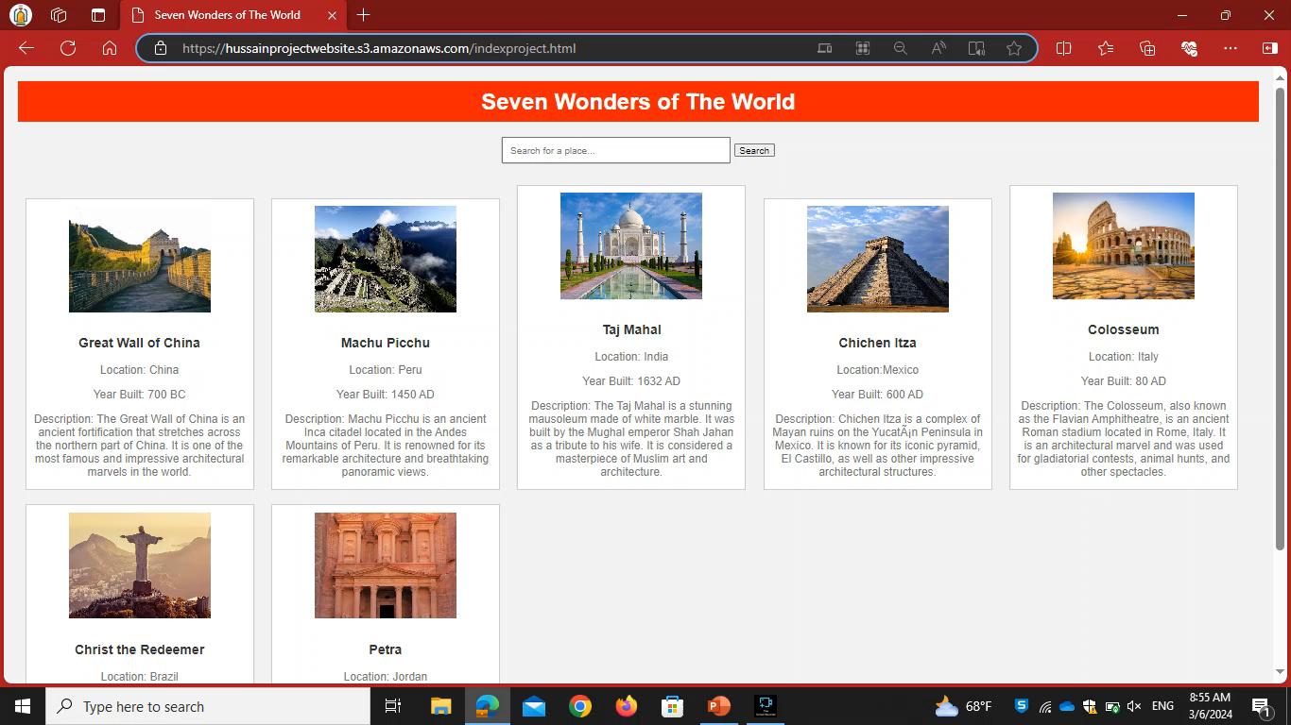
POC

Slide 10

Link and Conclusion :
Seven Wonders of The World (hussainprojectwebsite.s3.amazonaws.com)
The website is running on AWS and its secure and reliable
Also, the website help in discovering the amazing things about the seven-world wonders
Future implantations:
Maybe the future the website well have voice control for people that can use their hands
Another thing is to have a VR section that you can use to visit historical places

Slide 11

Any Questions ?

Slide 12
Thank you for your time by :Hussain Ali

